Slide 1
Queue

Slide 2
What is Queue?
A Queue is defined as a linear data structure that is open at both ends and the operations are performed in First In First Out (FIFO) order.
We define a queue to be a list in which all additions to the list are made at one end, and all deletions from the list are made at the other end. The element which is first pushed into the order, the operation is first performed on that.

Slide 3
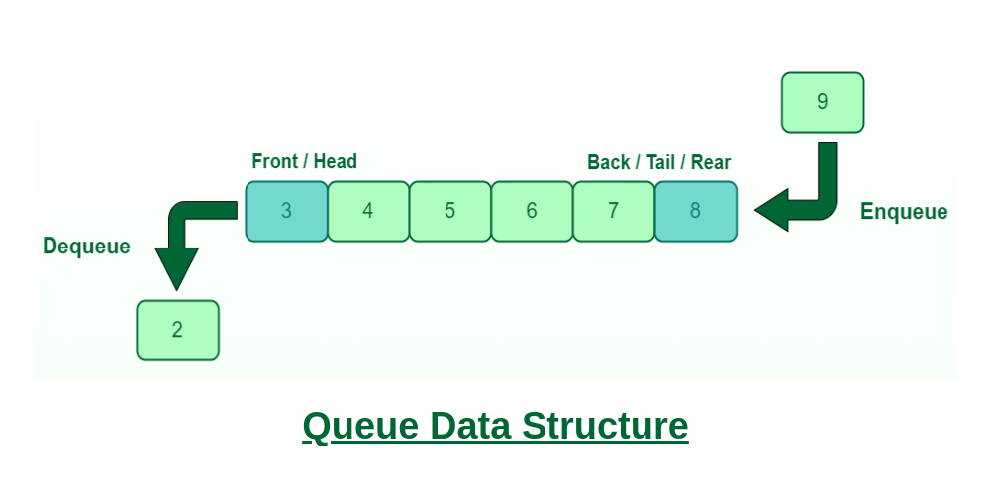

Slide 4
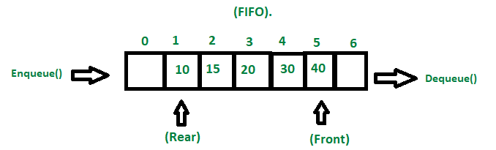
FIFO Principle of Queue:
A Queue is like a line waiting to purchase tickets, where the first person in line is the first person served. (i.e. First come first serve).
Position of the entry in a queue ready to be served, that is, the first entry that will be removed from the queue, is called the front of the queue(sometimes, head of the queue), similarly, the position of the last entry in the queue, that is, the one most recently added, is called the rear (or the tail) of the queue. See the below figure.

Slide 5
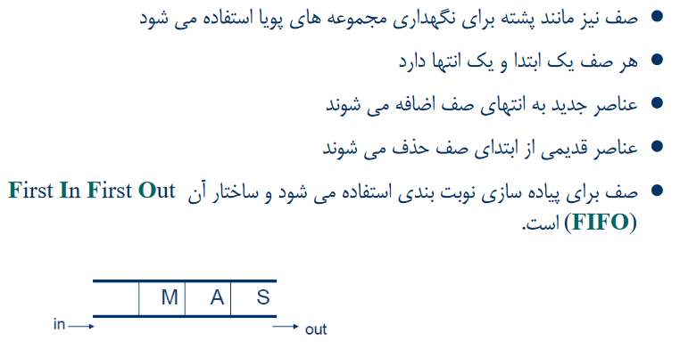

Slide 6
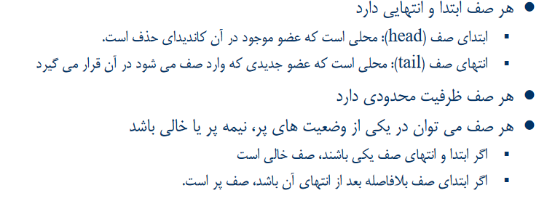

Slide 7
Basic Operations on Queue
In order to make manipulations in a Queue, there are certain operations provided to us.
Enqueue() – Adds (or stores) an element to the end of the queue.
Dequeue() – Removal of elements from the queue.
Peek() or front()- Acquires the data element available at the front node of the queue without deleting it.
rear() – This operation returns the element at the rear end without removing it.
isFull() – Validates if the queue is full.
isEmpty() – Checks if the queue is empty.
size() – returns the size of the queue i.e. the total number of elements it contains.

Slide 8
Implementation of Queue:
Using array
Using linked list

Slide 9







Array-based implementation
For implementing queue, we need to keep track of two indices, front and rear.
We enqueue an item at the rear and dequeue an item from the front.
If we simply increment front and rear indices, then there may be problems, the front may reach the end of the array.
The solution to this problem is to increase front and rear in circular manner.
Bus Stop
front
rear
rear
rear
rear
rear

Slide 10
Array-based implementation
Class Queue {
int front, rear, capacity;
int* queue;
// Constructor to initialize the queue
Queue(int c)
{
front = 0;
rear = -1;
capacity = c;
queue = new int[c];
}
// Destructor to free the allocated memory
~Queue() { delete[] queue; }
}
مثالی ساده از پیاده سازی صف با استفاده از آرایه:
اشاره گر ابتدای صف (front) همیشه ثابت است؛
اشاره گر انتهای صف (rear) تغییر می کند.

Slide 11
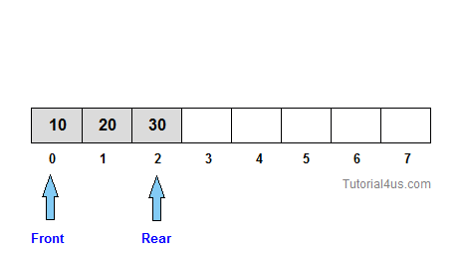
Array-based implementation
// Function to insert an element at the rear of the queue
void queueEnqueue(int data)
{
// Check if the queue is full
if (rear == capacity - 1) {
printf("\nQueue is full\n");
return;
}
// Insert element at the rear
queue[++rear] = data;
}

Slide 12
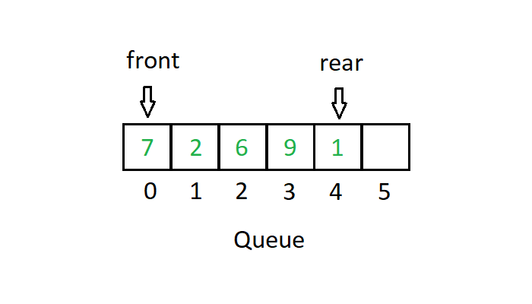
Array-based implementation
// Function to delete an element from the front
// of the queue
void queueDequeue()
{
// If the queue is empty
if (front > rear) {
printf("\nQueue is empty\n");
return;
}
// Shift all elements from index 1 till rear to
// the left by one
for (int i = 0; i < rear; i++) {
queue[i] = queue[i + 1];
}
// Decrement rear
rear--;
}

Slide 13
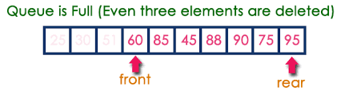
Circular-Array-based implementation
In a normal Queue, we can insert elements until queue becomes full. But once queue becomes full, we can not insert the next element even if there is a space in front of queue (without shifting)!

Slide 14
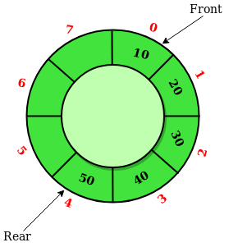
Circular-Array-based implementation
A Circular Queue is an extended version of a normal queue where the last element of the queue is connected to the first element of the queue forming a circle.
The operations are performed based on FIFO (First In First Out) principle. It is also called ‘Ring Buffer’.

Slide 15
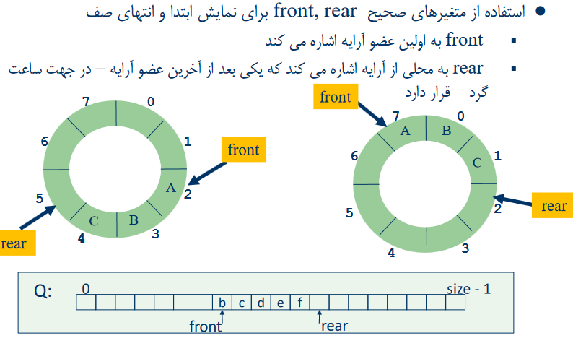
Circular-Array-based implementation

Slide 16
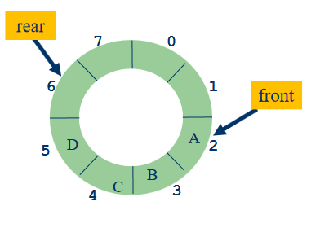
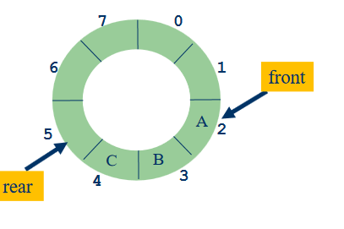
Circular-Array-based implementation
افزودن یک عضو
عضو جديد را در محلqueue[rear] قرار مي دهيم
Rear را در جهت ساعتگرد يك واحد جلو مي بريم

Slide 17
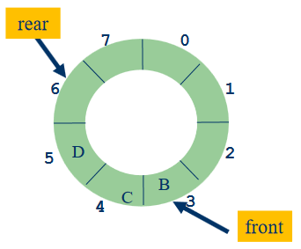
Circular-Array-based implementation
حذف یک عضو
عضوqueue[front]را مي خوانيم
Front را در جهت ساعتگرد يك واحد جلو مي بريم

Slide 18
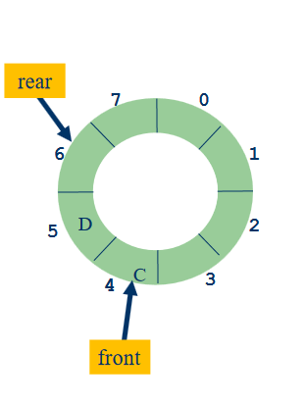
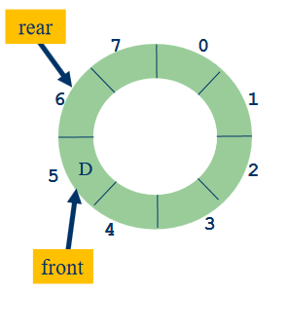
Circular-Array-based implementation
حذف یک عضو

Slide 19
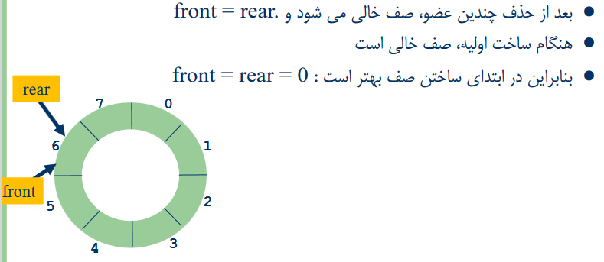
Circular-Array-based implementation
صف خالی

Slide 20
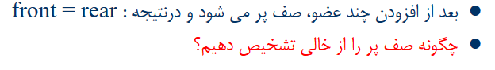
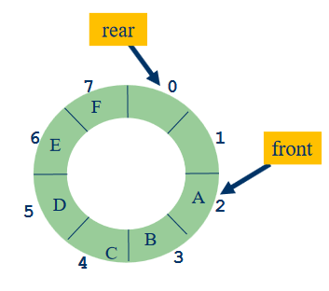
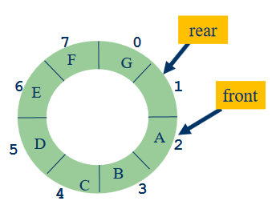
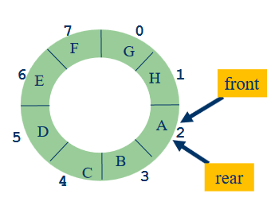
Circular-Array-based implementation
صف پر

Slide 21
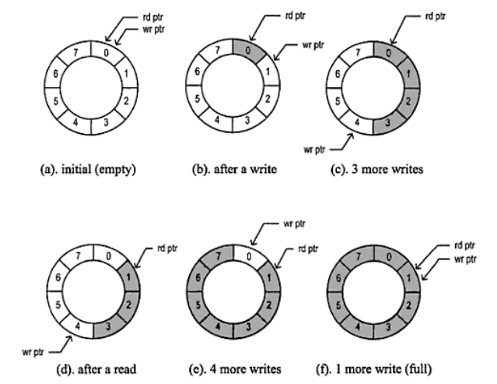
Circular-Array-based implementation
Both the “full” and “empty” cases of the circular buffer look the same: head and tail pointer are equal. There are two approaches to differentiating between full and empty:
“Waste” a slot in the buffer:
Full state is (tail + 1)%size == head
Empty state is head == tail
Use a bool flag and additional logic to differentiate states::
Full state is full
Empty state is (head == tail) && !full

Slide 22
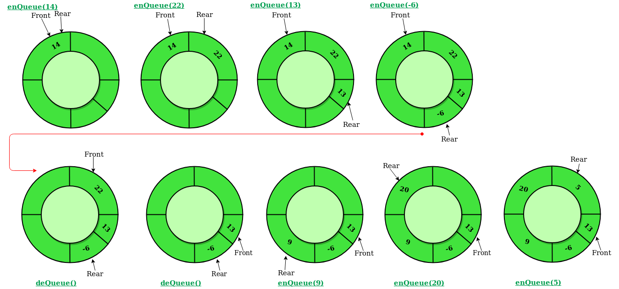
پیاده سازی دیگری از صف چرخشی
در این حالت rear به آخرین خانه ی صف اشاره میکند.
Empty: front==rear==-1
Full : front== (rear+1)%size
در این پیاده سازی در تابع deQueue چک میکنیم اگر front==rear یعنی تنها یک المنت در صف قرار دارد بنابراین پس از حذف آن صف خالی شده و دو ایندکس front , rear را 1- قرار میدهیم.

Slide 23
Linked list-based implementation
we maintain two pointers, front, and rear. The front points to the first item of the queue and rear points to the last item.
enQueue(): This operation adds a new node after the rear and moves the rear to the next node.
deQueue(): This operation removes the front node and moves the front to the next node.

Slide 24
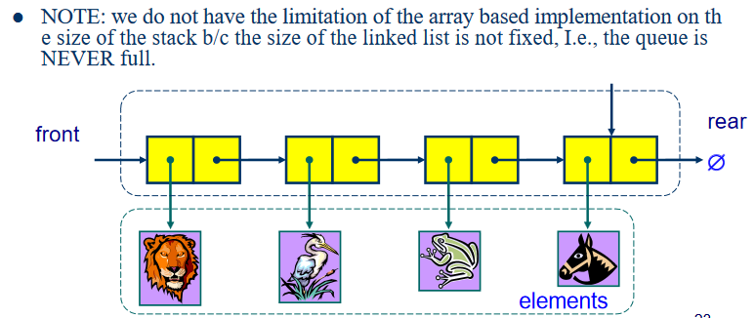
Linked list-based implementation

Slide 25
Linked list-based implementation
class Queue {
Node *front, *rear;
public:
Queue() { front = rear = NULL;}
bool enQueue(int x);
int deQueue();
int peek();
bool isEmpty();
};

Slide 26
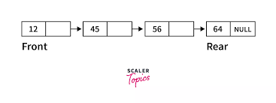
Linked list-based implementation
bool Queue::enQueue(int x)
{
Node *newnode;
newnode = new Node;
newnode->data = x;
newnode->next = NULL;
if(front == NULL) // Queue is empty
front = rear = newnode;
else
{
rear->next = newnode;
rear = newnode;
}
}

Slide 27
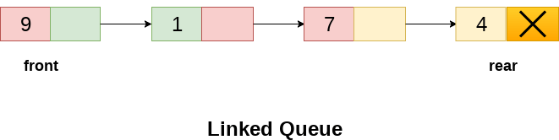
Linked list-based implementation
int Queue::deQueue()
{
if (isEmpty())
throw EmptyQueueException;
else {
Node *temp;
temp= front;
front = front->next;
int key=temp->data;
free(temp);
return key;
}
}

Slide 28
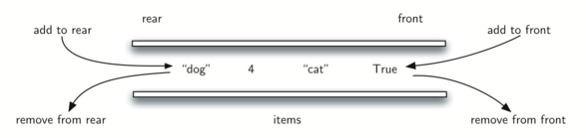
Double-ended queue

Slide 29
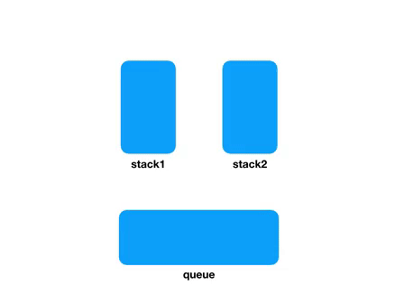
پیاده سازی صف با 2 استک

Slide 30
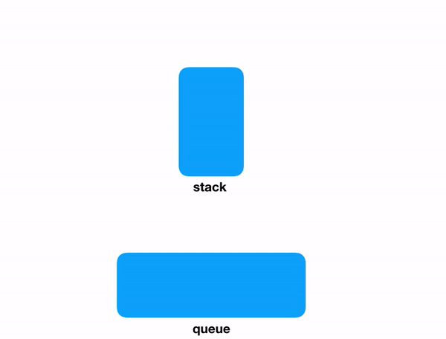
پیاده سازی استک با صف

Slide 31
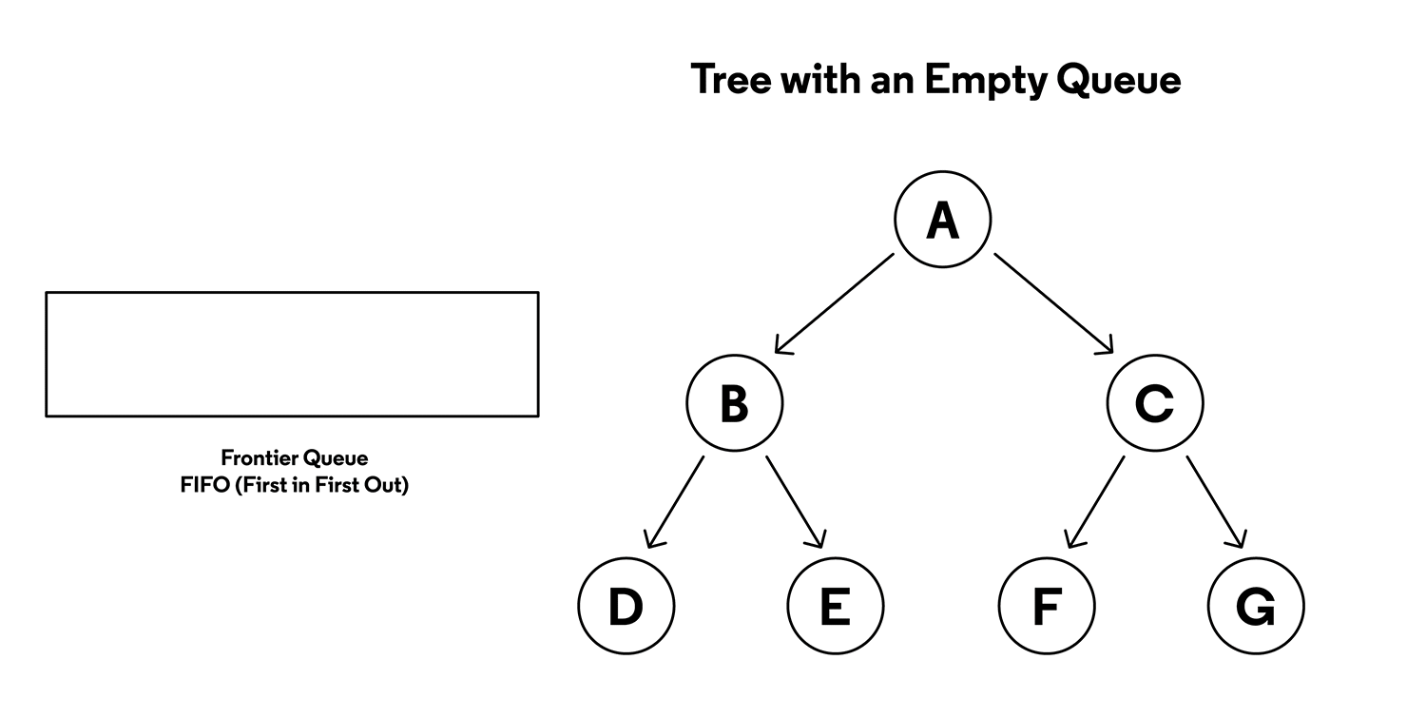
کاربرد صف در پیمایش درخت و گراف
Breadth First traverse (پیمایش اول سطح)

Slide 32
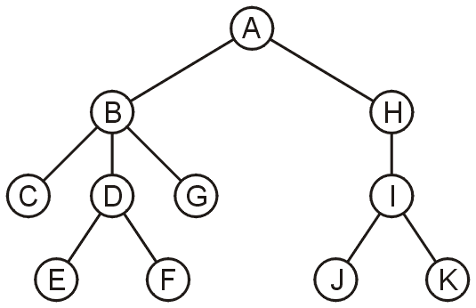
Application
An application is performing a breadth-first traversal of a directory tree
Consider searching the directory structure

Slide 33
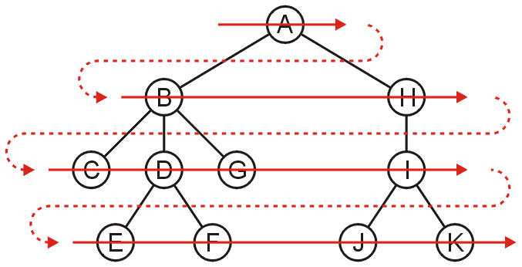
Application
We would rather search the more shallow directories first then plunge deep into searching one sub-directory and all of its contents
One such search is called a breadth-first traversal
Search all the directories at one level before descending a level

Slide 34
Application
The easiest implementation is:
Place the root directory into a queue
While the queue is not empty:
Pop the directory at the front of the queue
Push all of its sub-directories into the queue
The order in which the directories come out of the queue will be in breadth-first order

Slide 35
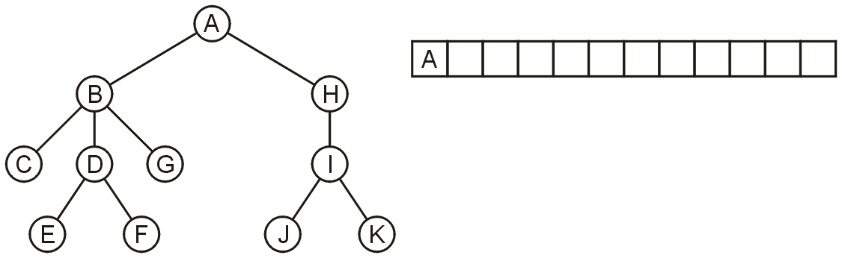
Application
Push the root directory A

Slide 36
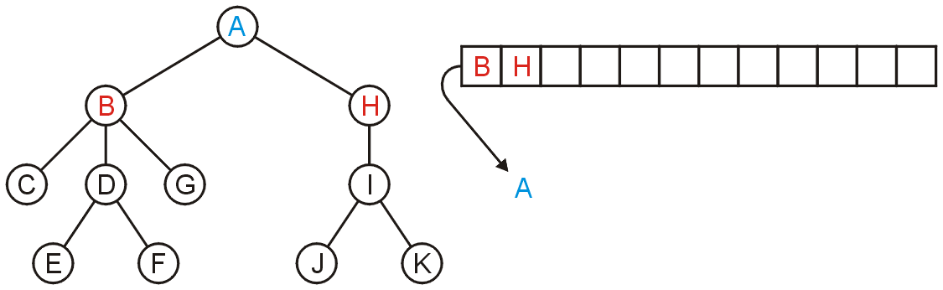
Application
Pop A and push its two sub-directories: B and H

Slide 37
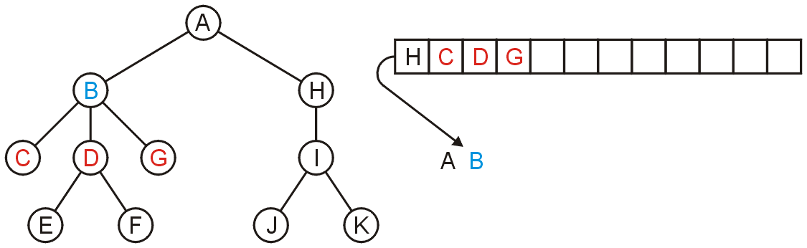
Application
Pop B and push C, D, and G

Slide 38
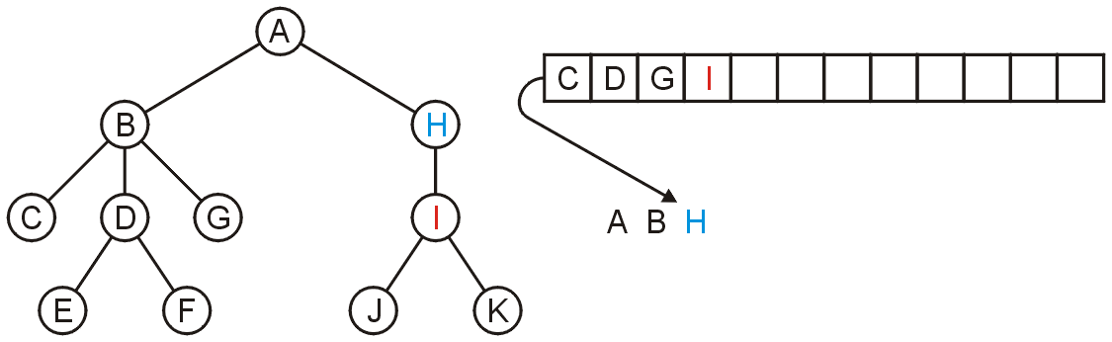
Application
Pop H and push its one sub-directory I

Slide 39
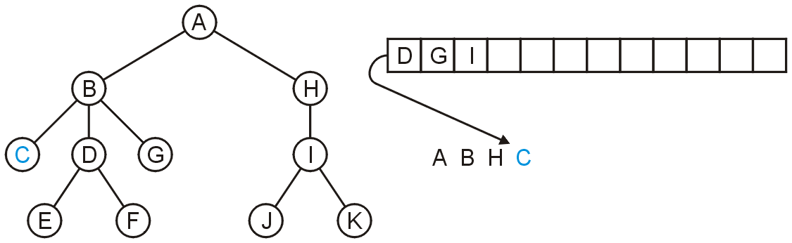
Application
Pop C: no sub-directories

Slide 40
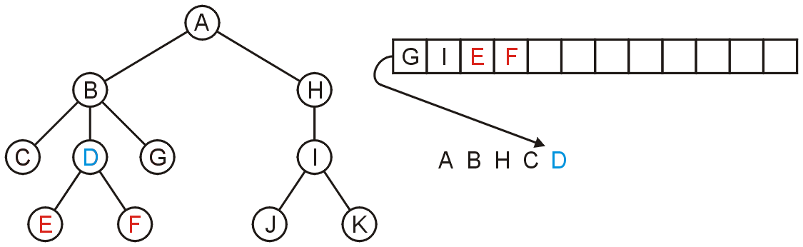
Application
Pop D and push E and F

Slide 41
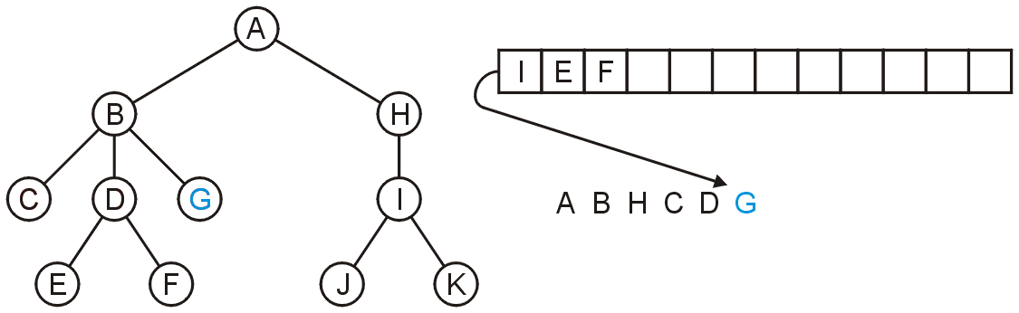
Application
Pop G

Slide 42
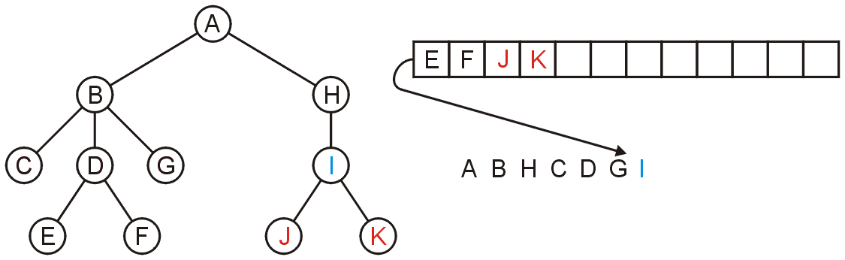
Application
Pop I and push J and K

Slide 43
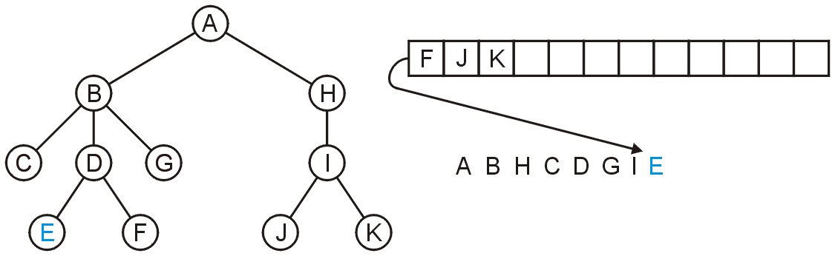
Application
Pop E

Slide 44
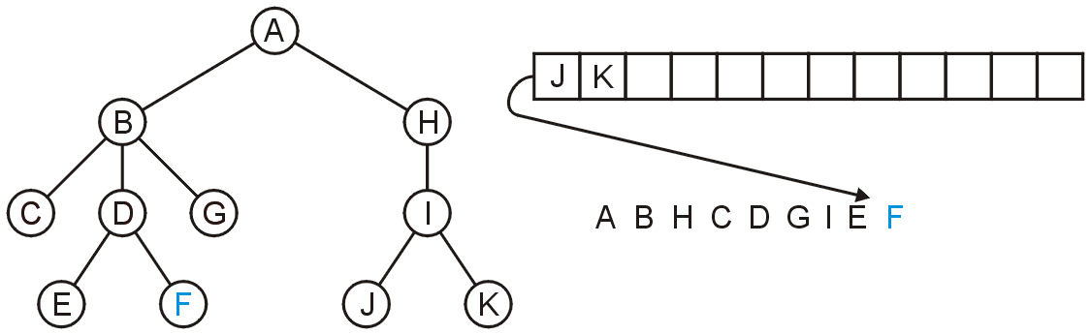
Application
Pop F

Slide 45
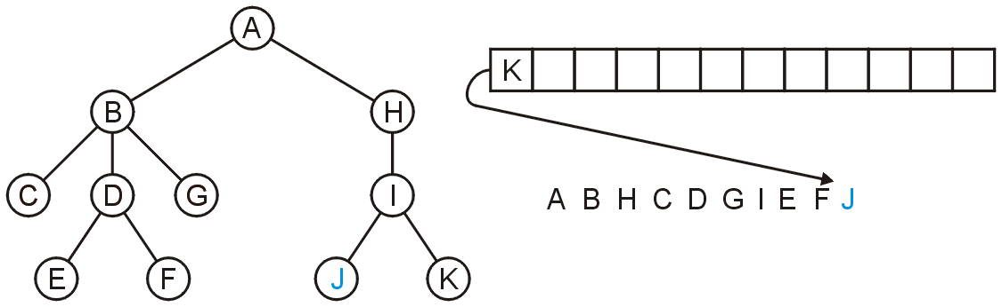
Application
Pop J

Slide 46
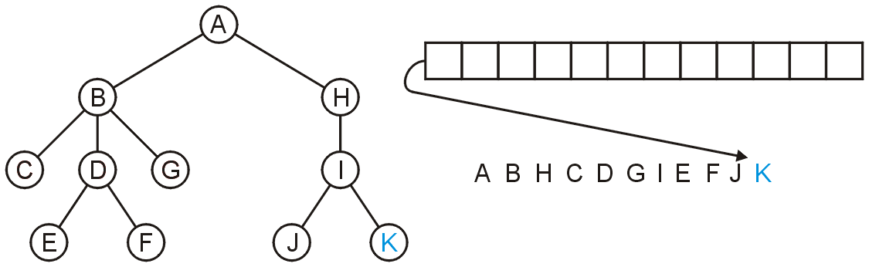
Application
Pop K and the queue is empty

Slide 47
Application
The resulting order
A B H C D G I E F J K
is in breadth-first order:

Slide 48
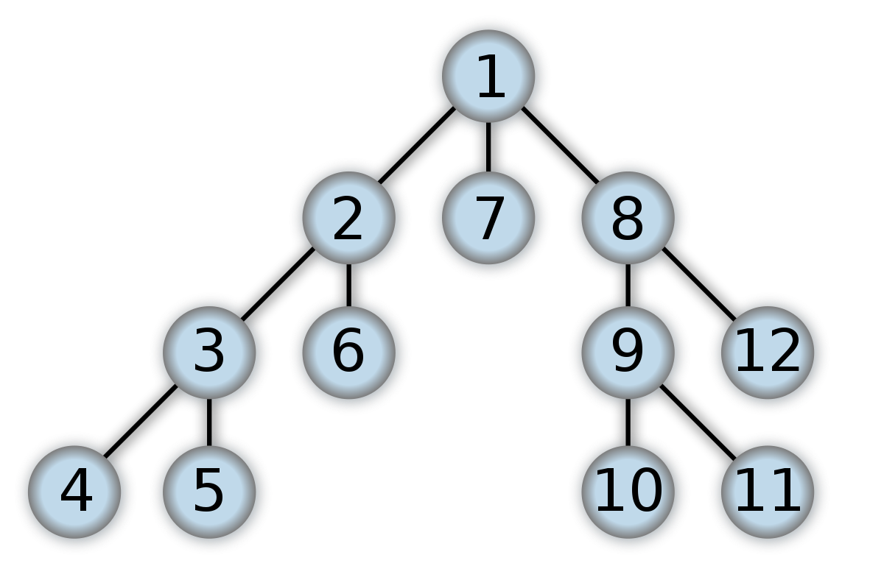
درخت را به صورت اول سطح پیمایش کنید

Slide 49
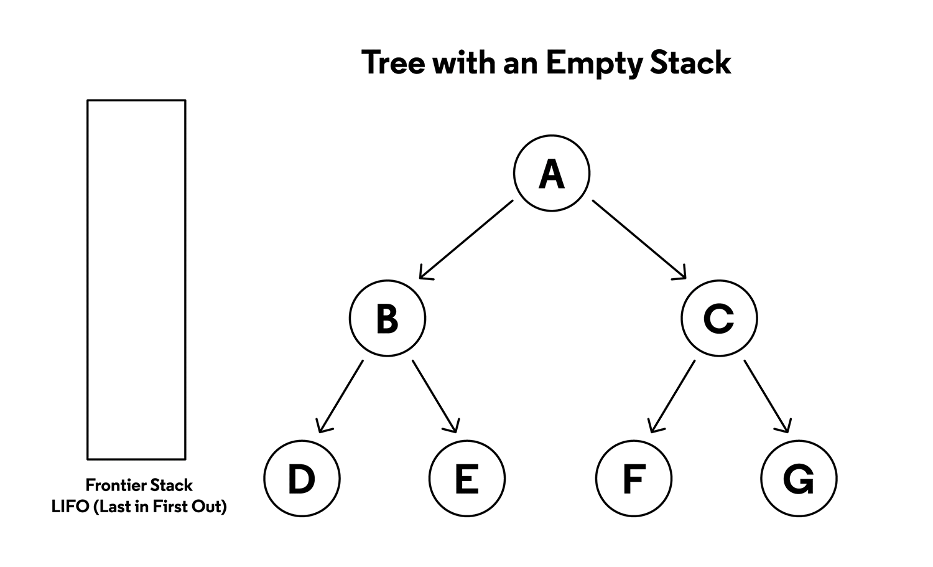
کاربرد پشته در پیمایش درخت و گراف
Depth First traverse (پیمایش اول عمق)

Slide 50

درخت را به صورت اول عمق پیمایش کنید

